Slide 1
ParSurf
ParSurf – parallel coordinates surface visualization.
Visualizes surfaces in parallel and Cartesian coordinates.
Handles surfaces in arbitrary dimensions.
Contains Tools for arbitrary transforming surfaces.
Accepts surfaces defined by a parametric equation or a point cloud.

Slide 2
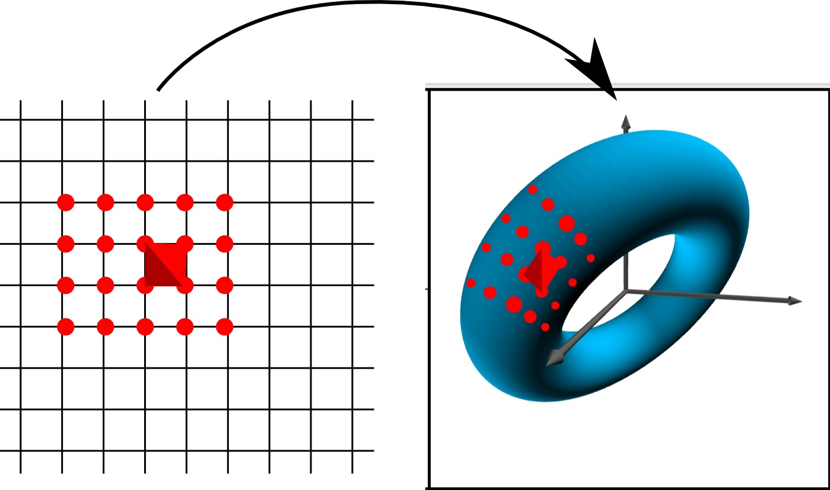
How It Works – Parametric Surface
A 2X2 grid is transformed using the parametric equations to a grid on the surface.
Triangles from grid points define approximately tangent planes.
Planes visualized in
parallel coordinates.

Slide 3
How It Works – Point Cloud
Restricted to surfaces in three dimensions.
A Delaunay triangulation of the points is calculated.
The exterior faces of it are selected.
Selected triangles define approximately tangent planes.
Planes visualized in parallel coordinates

Slide 4
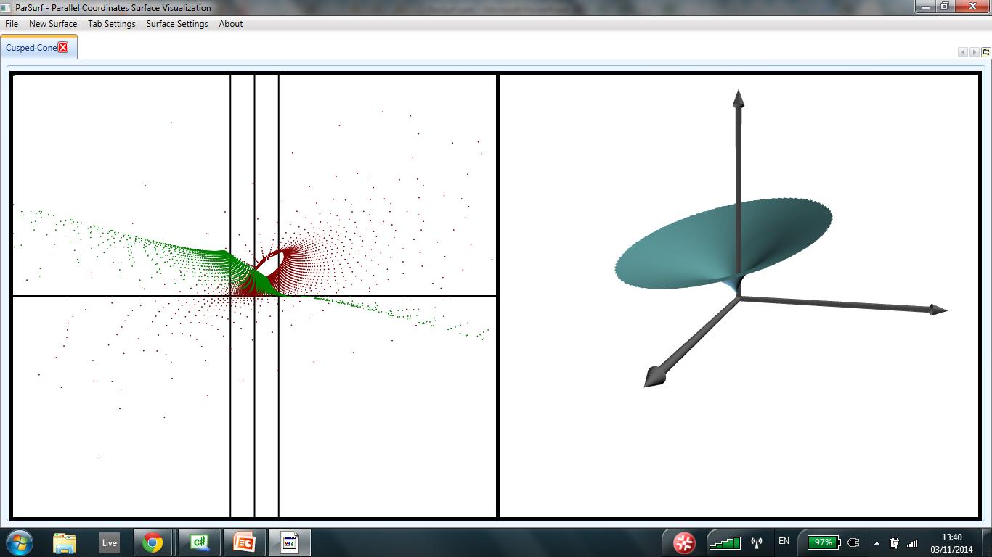
How it looks like – 3D

Slide 5
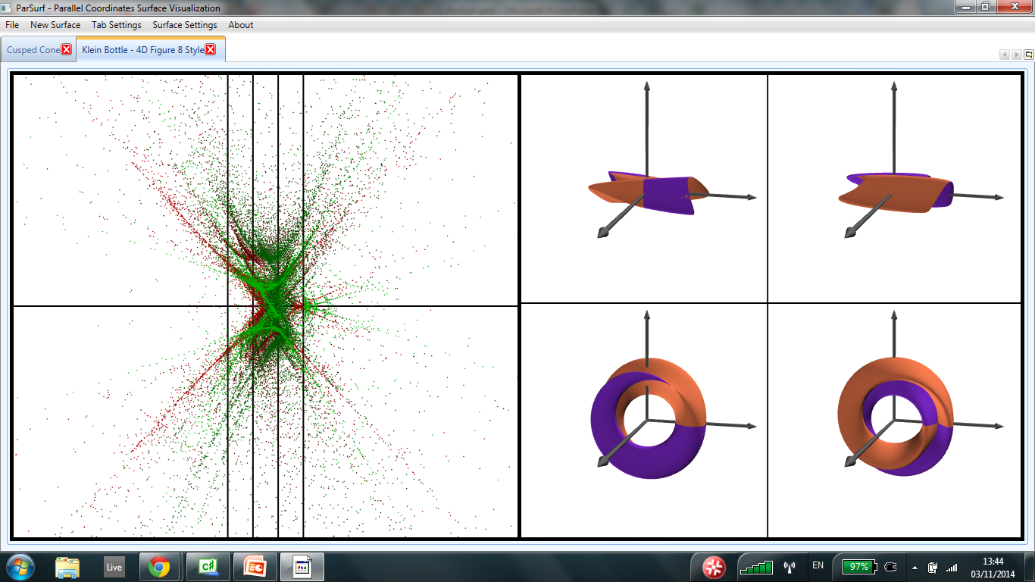
How it looks like – 4D
Projection unto all axes triplets

Slide 6
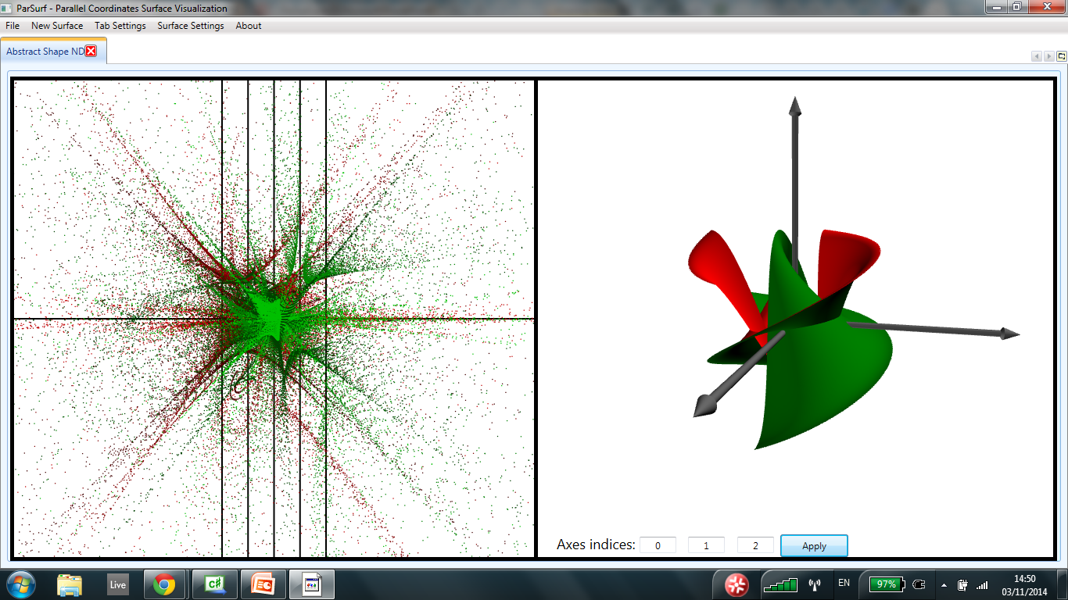
How it looks like – ND
Projection unto three chosen axes

Slide 7
Value As Research Tool
Enables the study of the relations between properties of surfaces to patterns in parallel coordinates.
Provides the ability to relate transformations in higher dimensions to transformations in parallel coordinates.
Can be used to interpret and study real world data as point-cloud surfaces.

Slide 8
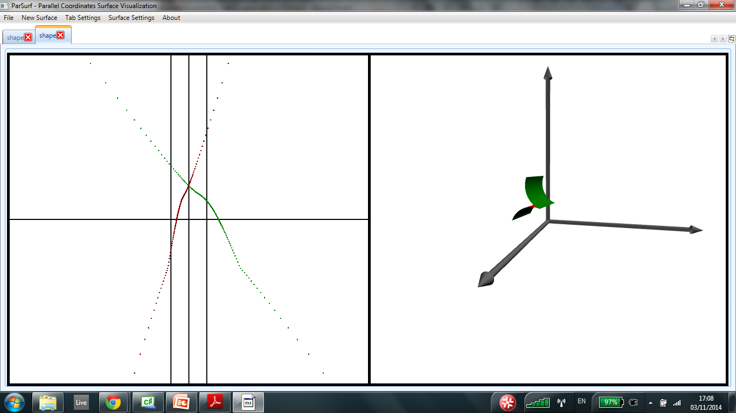
Examples: Cusp-inflection Relation (ruled surface)

Slide 9
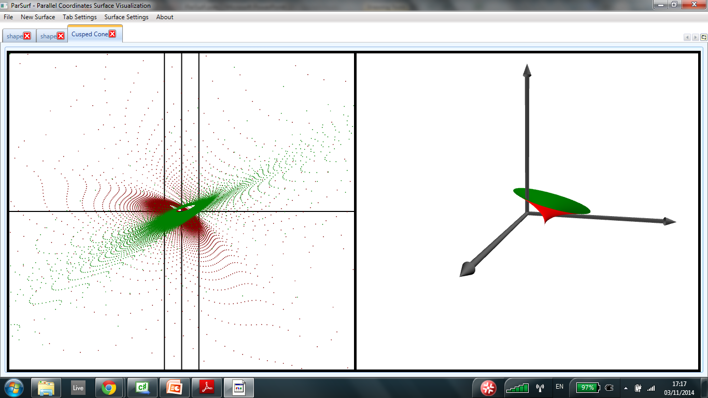
Examples: Cusp in non-ruled surface (emergent relation?)

Slide 10
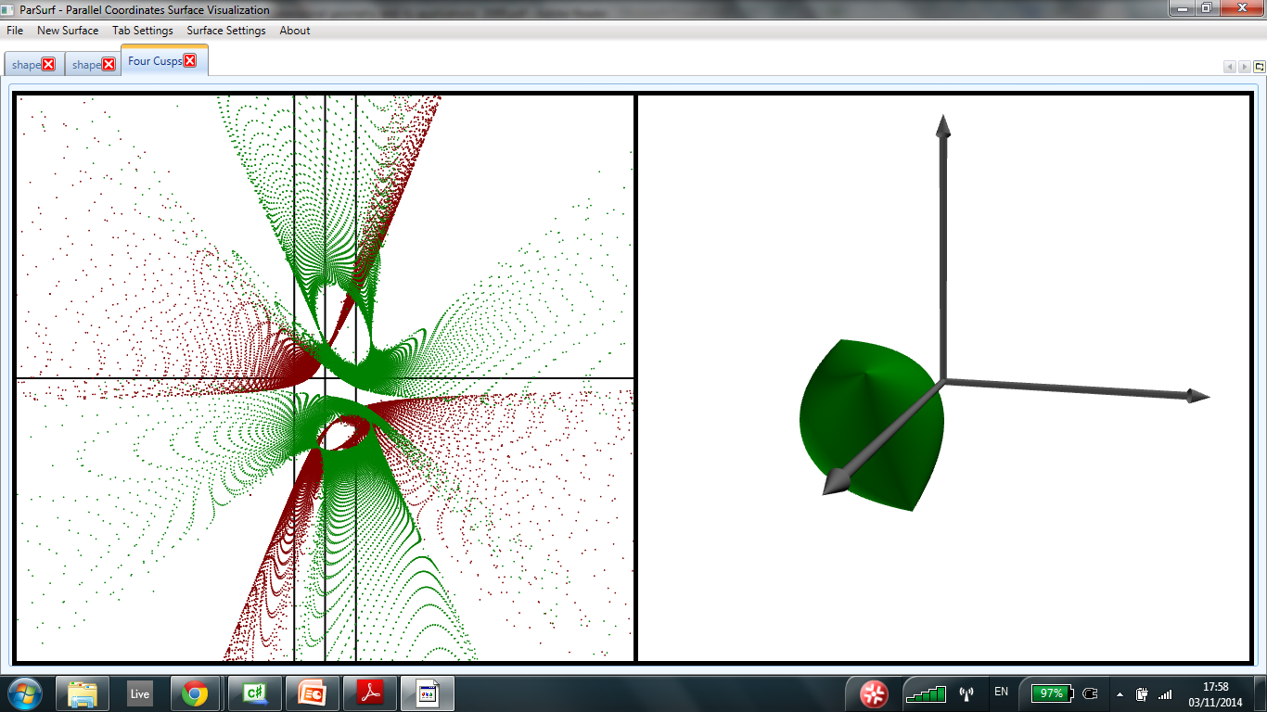
Examples: Cusp in non-ruled surface (emergent relation?)

Slide 11
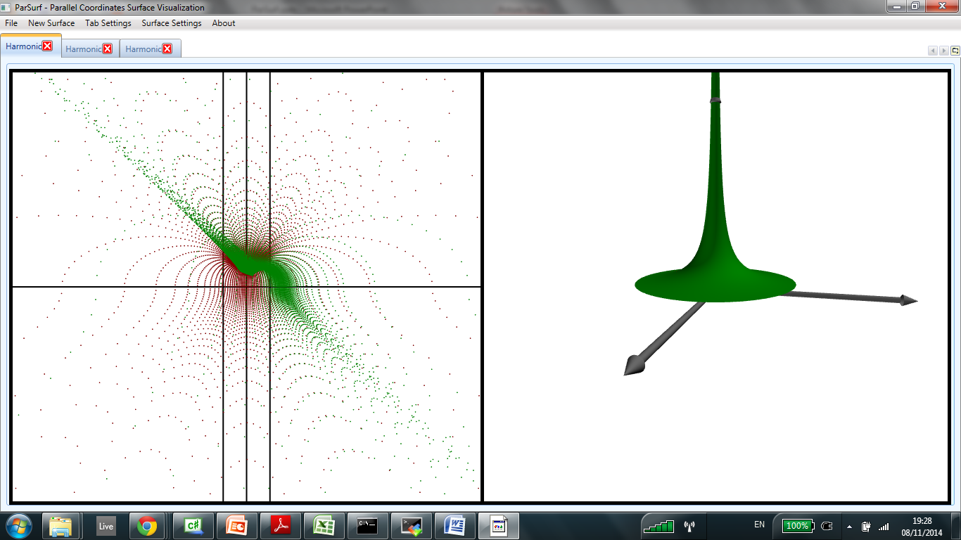
Examples: Cusp at ideal point

Slide 12
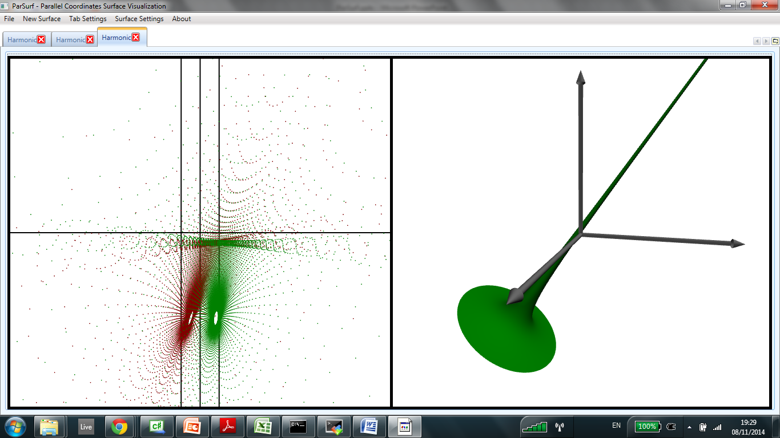
Examples: Cusp at ideal point

Slide 13
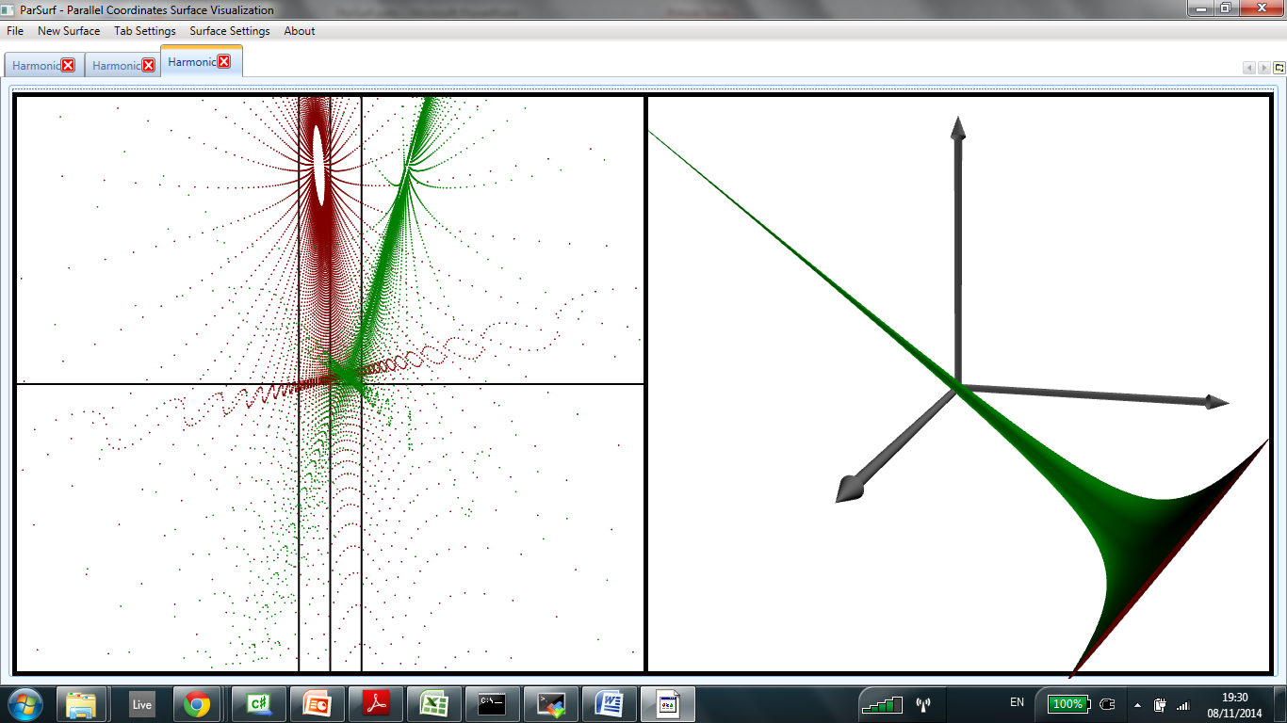
Examples: Cusp at ideal point

Slide 14
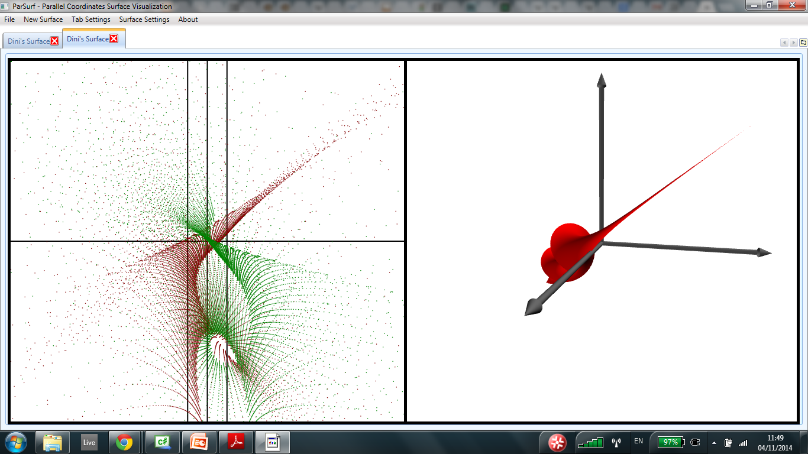
Examples: Cusp at ideal point

Slide 15
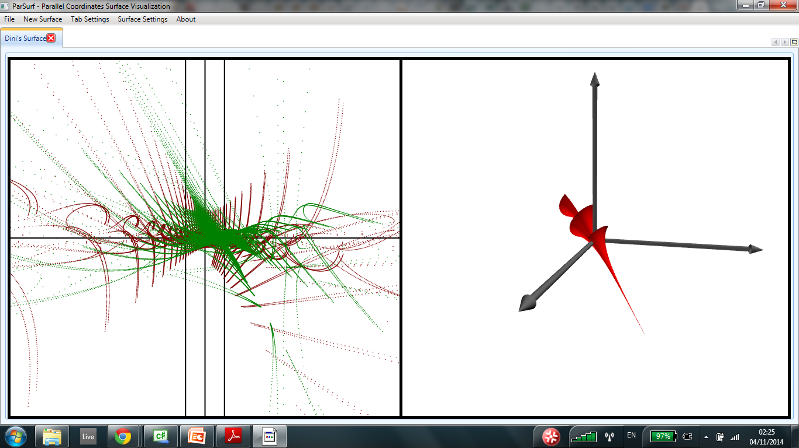
Examples: Cusp at ideal point

Slide 16
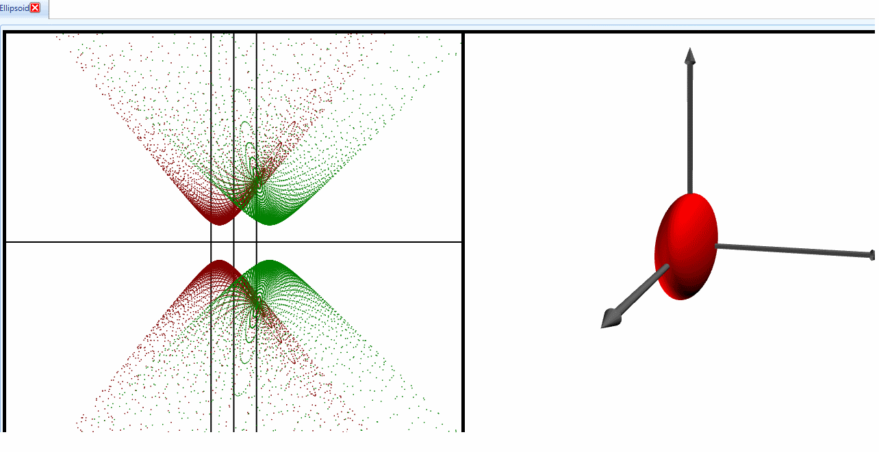
Examples: Rotation

Slide 17
Usage – Transforming Shapes

Slide 18
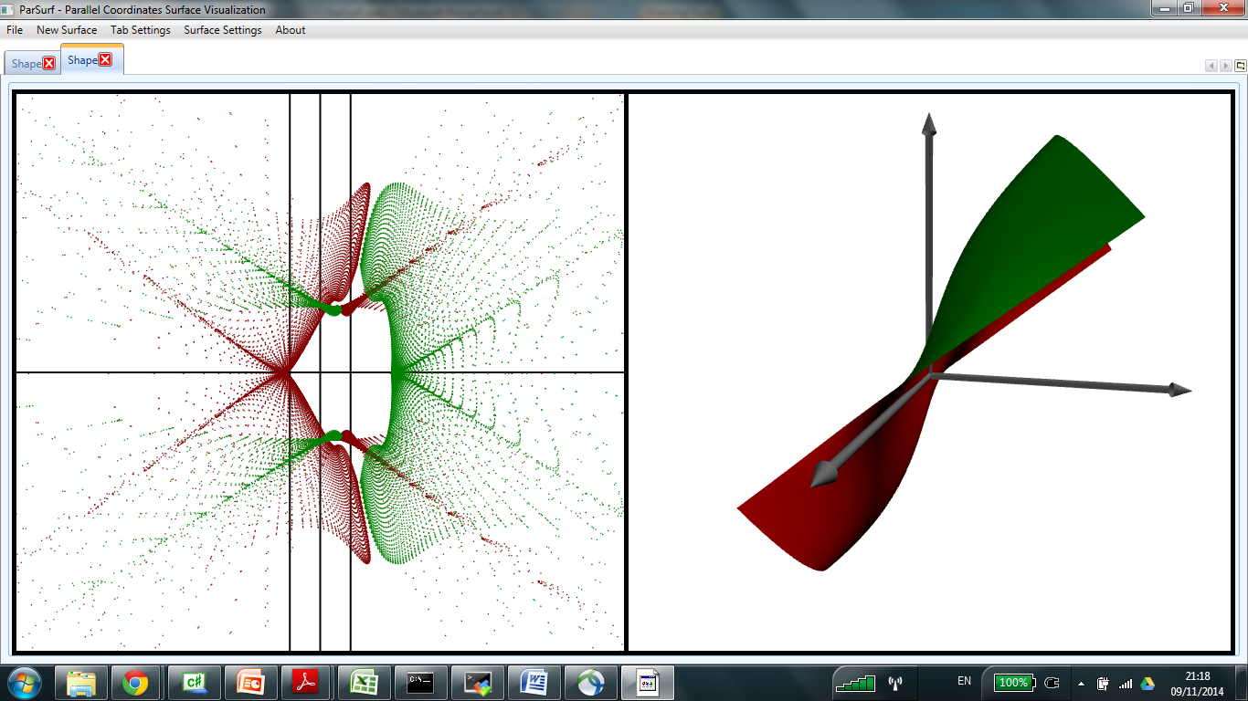
Rotation
To rotate a surface, use the left mouse button

Slide 19
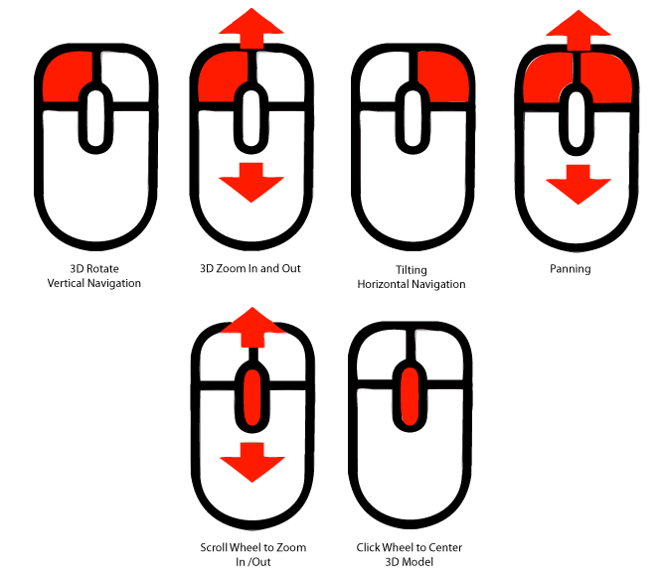
Rotation
Hold the mouse and move it along a line

Slide 20
Rotation
The rotation axis is contained in the XY plane

Slide 21
Rotation
Rotation axis perpendicular to the line drawn
and goes through the origin

Slide 22
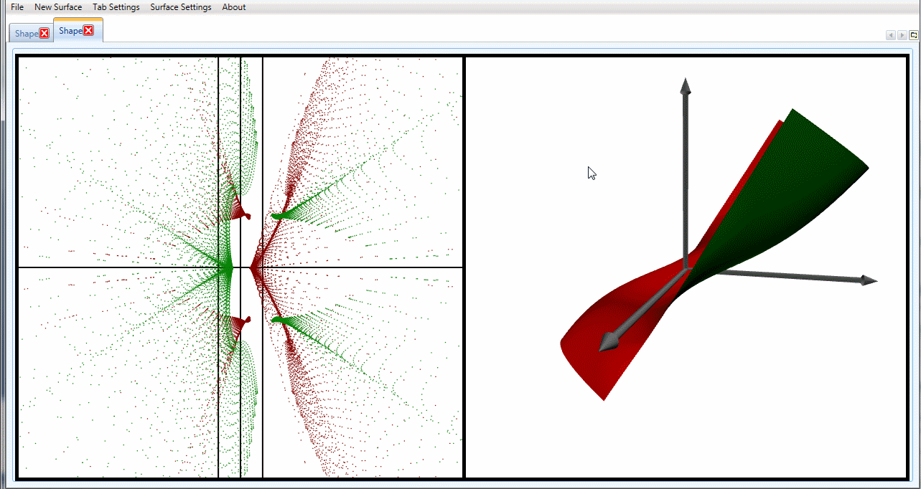
Rotation

Slide 23
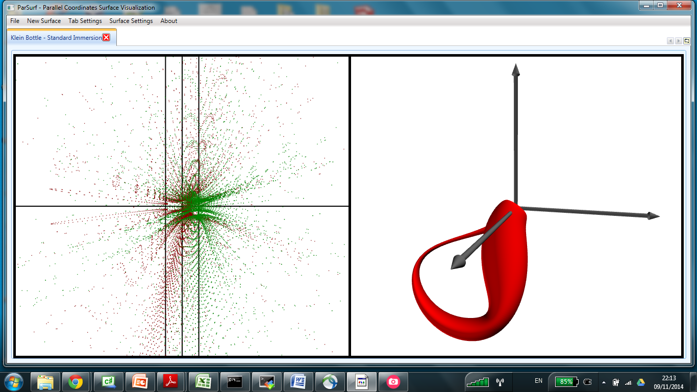
Translation
To translate a surface, use the right mouse button

Slide 24
Translation
Hold the mouse and move it along a line

Slide 25
Translation
Movement is along the same line, in XY plane

Slide 26
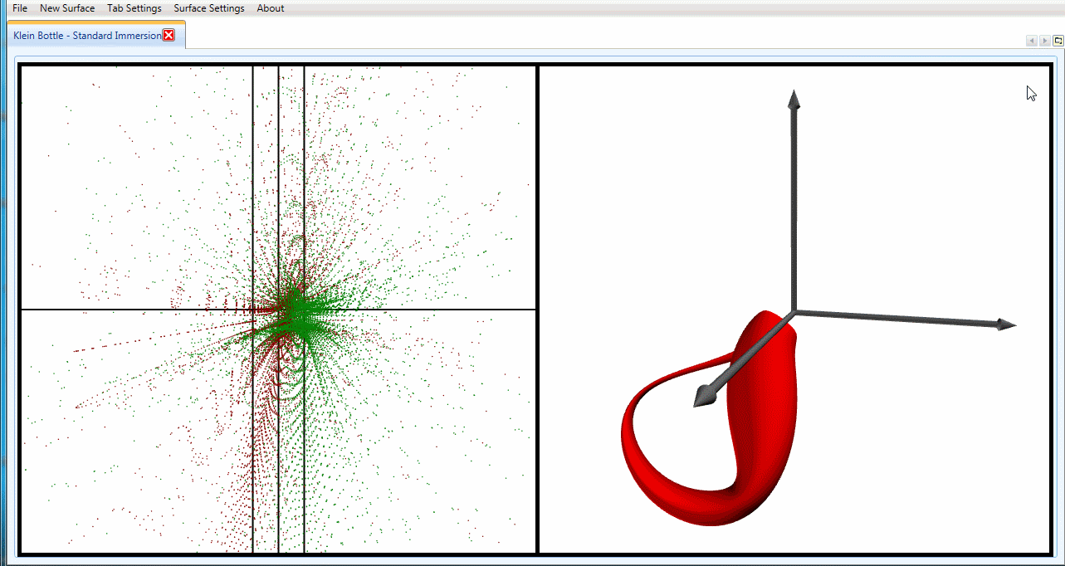
Translation

Slide 27
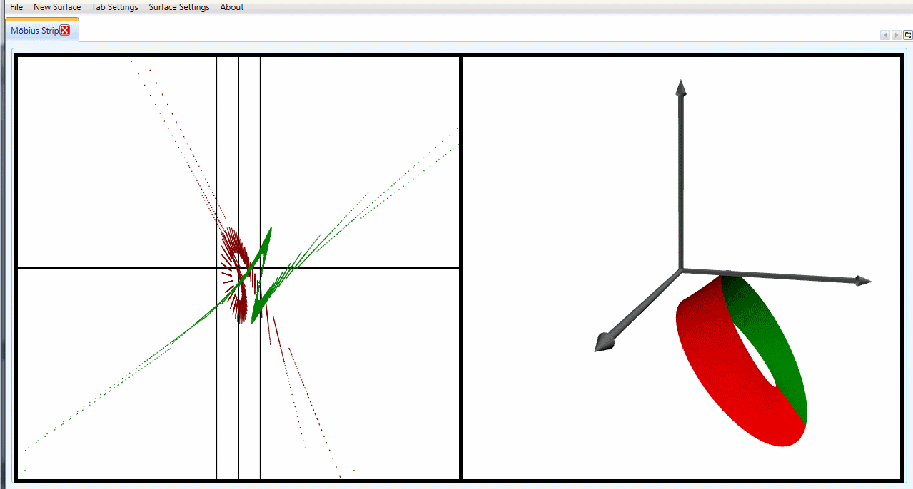
Translation
Canvas can also be translated

Slide 28
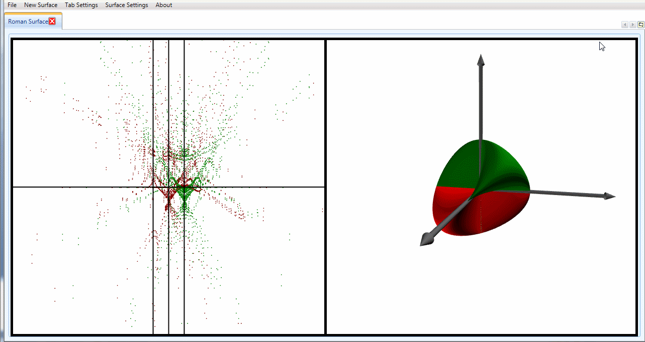
Scaling
To scale a surface, use the mouse wheel
Scaling is done from the origin

Slide 29
Transformations
When manipulating higher dimensional surfaces, transformation is done on a projection
This translate to a transformation in ND that is the identity on all axes except the ones projected unto
Note that it means that disjoint projections, and corresponding Pi_ijk identifiers, are not affected
Corollary – Pi_ijk points are local – represent aspects of shapes that can be represented with three axes

Slide 30
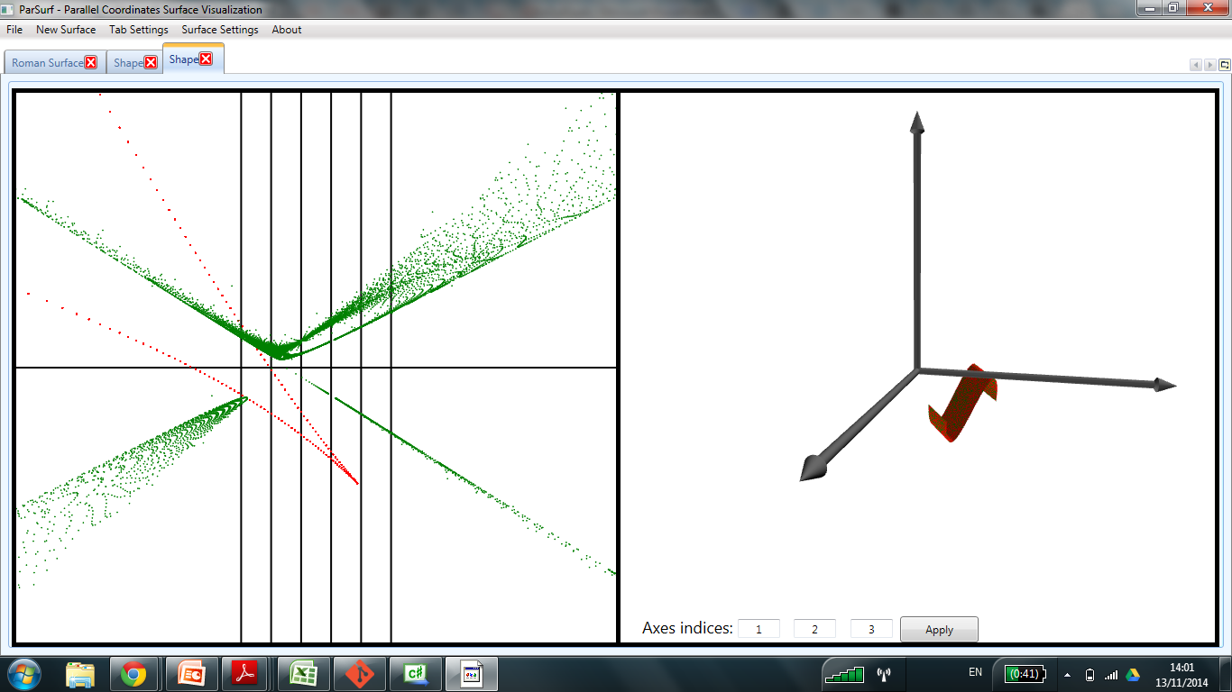
Transformations
Pi_456’
Pi_123

Slide 31
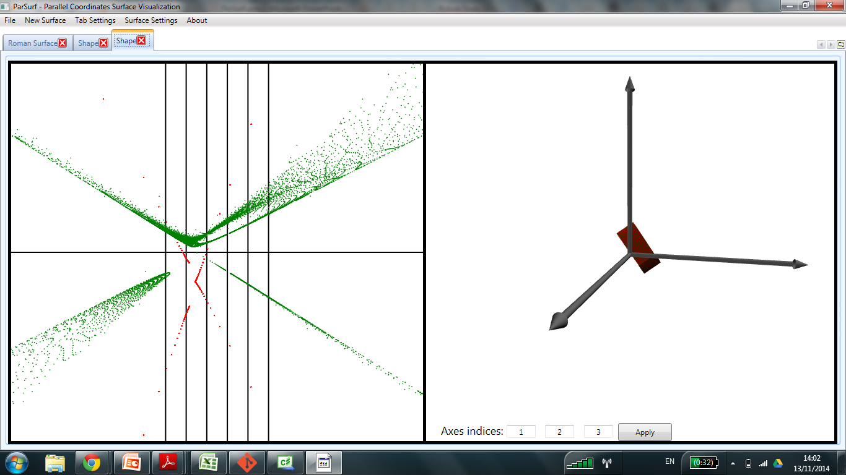
Transformations
Pi_456’
Pi_123

Slide 32
Transformations
Notice the blank ellipse?
Recall the examples!

Slide 33
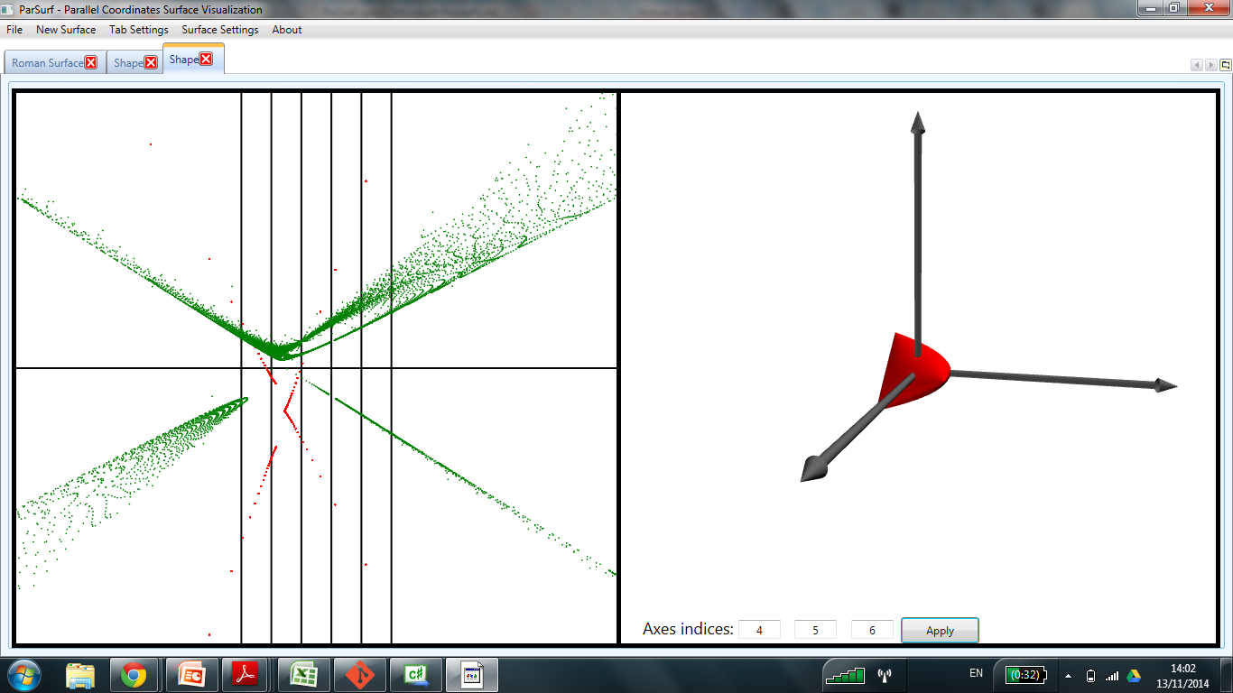
Transformations
Blank ellipse in Pi_456’
points represents cusp in
the projection!

Slide 34
Transformations
Both rotation and translation use lines from the XY plane as axes
Achieving a complex transformation takes several steps
Practice!
Exact transformations can be done via a transformation matrix – see section about menus

Slide 35
Usage - Menus

Slide 36
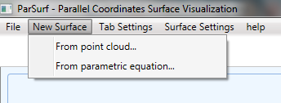
Creating New Surfaces

Slide 37
Point Cloud Surface
Input a CSV file, each row representing a point.
Software finds a Delaunay triangulation of the point cloud.
Not guaranteed to succeed.
Resulted surface not guaranteed to most intuitively represent the point cloud.

Slide 38
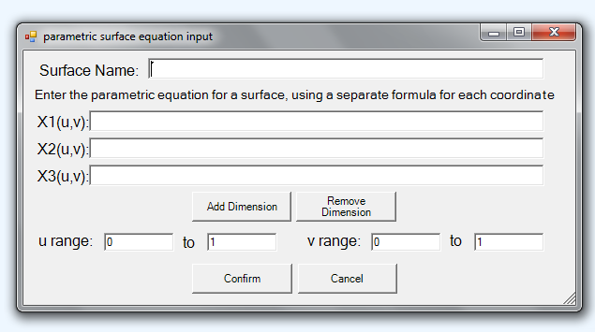
Parametric Surface
When opening this window with a surface loaded, its equations show up
Enter a formula for each coordinate, in terms of u and v.
Accepts basic mathematical functions
e.g. Sin,Cos,Pow etc.
User parameters can be defined by prefixing with a $ sign.
Use to define surfaces in higher dimensions.
Full function list at - https://ncalc.codeplex.com/wikipage?title=functions

Slide 39
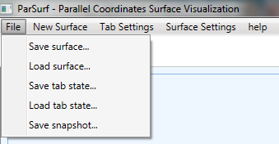
Loading And Saving
Surfaces can be saved and loaded at later software runs, or transferred between computers
Tab states include information on surface transformation and viewing options
The generated images of a surface can be saved to file as a snapshot

Slide 40
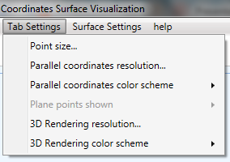
Tab Settings
Controls the size of points in the parallel coordinates view
Controls the quality of the
surface approximization in parallel coordinates
Controls the triply indexed plane points shown in the parallel coordinates visualization
Controls the quality of the
surface approximization in 3D
Color schemes deal with the colors used in either visualization

Slide 41
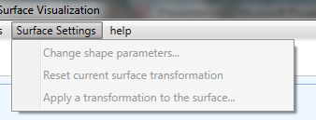
Tab Settings
For parametric surfaces with extra parameters, adjust their values
Control the transformation currently applied to the surface, via a (N+1)X(N+1) transformation matrix

Slide 42
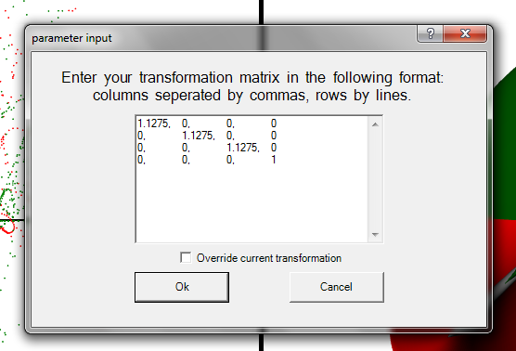
Transformation
Window opens with current transformation matrix, so it can be copied to another surface
Transformation matrix is a (N+1)X(N+1) affine transformation matrix
Transformation can occur after previous transformations, or override them

Slide 43
Enjoy using ParSurf!
For questions contact:
Ariel Brunner (arielbro@mail.tau.ac.il)
Ron Kirsch (ronyk1@gmail.com)
Kirill Savchenko (kirillsa@mail.tau.ac.il)

